Slide 1
EFFECT Final event
Brussels, 4° October 2023
Europaregion Tirol-Sudtirol Trentino, h 9-13

Slide 2
Environmental Public Goods From Farming Through Effective Contract Targeting
Mette Termansen, UCPH
EFFECT End Meeting
October 4, 2023

Slide 3
Background for the project
Agri-Environmental Schemes have, since the 1990s, been the primary policy instrument to meet environmental and climate objectives in Europe by supporting farmers to adopt more sustainable practices.
Little evidence of their success and the call asked for a review of lessons learned as well as designing and testing new forms of AES
Traditional AES are based on uniform payments in return for adoption of specific management intervention
Traditional AES “payment & adoption agreements” (i.e. the contracts) are between a government agency and the individual farmer
Farmers are compensated for the costs of adoption and income forgone

Slide 4


Background for the project
KEY CHALLENGES AND TRADE-OFFS IN DESIGN:
Tension between income support function
and environmental performance
Agri-environmental schemes are voluntary –participation is essential, but additionality of the schemes have been challenged
Non-point source pollution – challenging to regulate
NPS

Slide 5


Background for the project
KEY CHALLENGES:
Heterogeneous agri-environmental landscapes – targeting is essential for environmental and cost-effectiveness
Social norms and institutions demands that both voluntary and mandatory schemes should be fair
Asymmetric information between farmers and agency – design and monitoring challenges
Buyer
Seller

Slide 6
KEY Terminology
RESULTS vs. PRACTICE | Results-based AES are contracts where payment is wholly or partly dependent on outcomes being achieved. Farmers are directly incentivised to deliver the outcomes. The more outcomes they deliver, the more they will be paid. Practice-based AES are contracts where payments are based on the management practises undertaken with expected effect on the desired outcome.
INDIVIDUAL vs. COLLECTIVE | Individual contracts are between an individual farmer and the contracting agency Collective contracts are contracts where the payments are designed to take into account the behaviour of groups of farmers. These include a continuum of contract types that directly or indirectly seek to incentivise collaboration/coordination for sustainable outcomes.

Slide 7


Who are involved

Slide 8
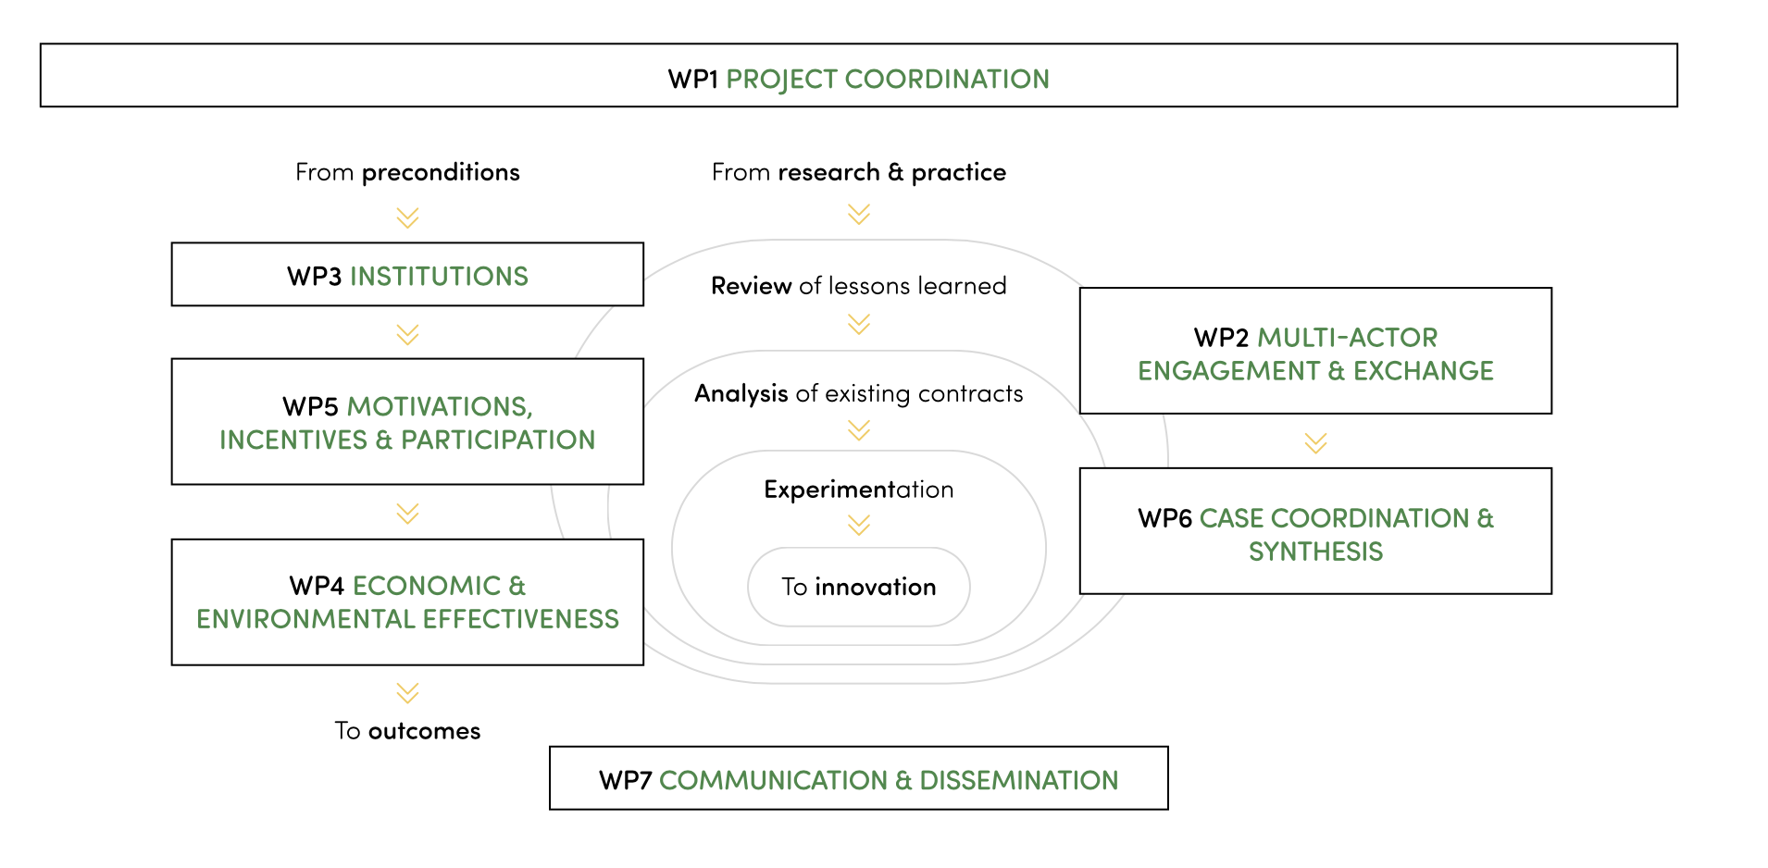
EFFECT – project organisation

Slide 9
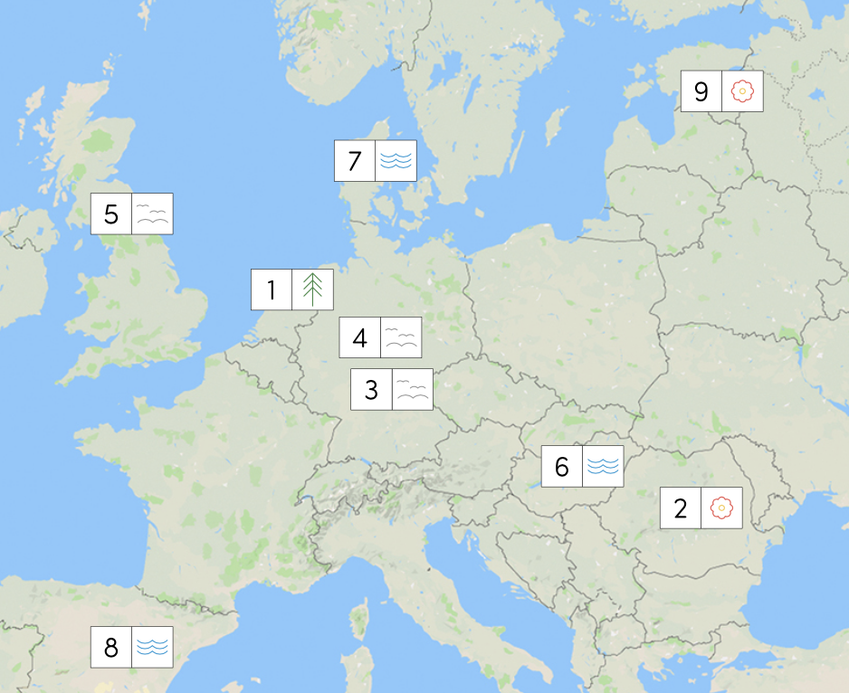




EFFECT – Cases

Slide 10
EFFECT – how do we test contracts
Policy Cycle
EXSISTING
SCHEMES
NEW
SCHEMES
Policy
Problem
Policy Formula-tion
Policy
choices
Policy Implemen-tation
Policy Evaluation
Statistical economics &
environmental impact
evaluation
Interviews/surveys with
stakeholders about their
experiences
Country case comparisons
Ecological surveys
Environmental–Economic
modelling
Surveys
Social experiments
Cost-effectiveness
Analysis
Ecological treatments

Slide 11

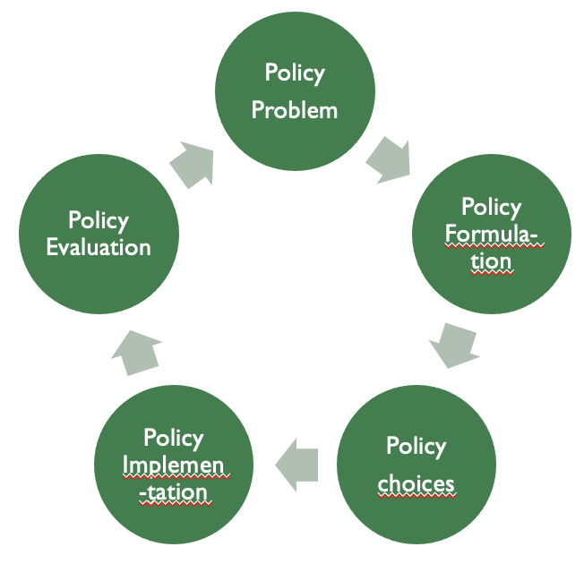
Plan for the day

Slide 12
A conceptual framework for analyzing AES impacts
Brussels, 4 October 2023
Sven Wunder, with Cecilia Fraccaroli & Mette Termansen

Slide 13
AES Theory of Change
INPUTS
TREATMENTS
OUTPUTS
OUTCOMES
IMPACTS
Legal-administrative framework
AES intermediaries
Financing sources
Contract length & terms
Action vs. result based
Individual vs. collective contracts
Preservation vs. modification of practices
Flexibility
Bottom-up vs top- down design
Institutional needs
Conditional incentive design
Farmers participate at adequate scale
AES recipients adopt desirable agricultural practices/ actions
ES benefits enhanced vis-à-vis baseline (targets reached)
Farmers understand/ accept treatment(s)
Changes range from land cover and use to production inputs and practices
Baseline vs. treatment scenarios vis-à-vis threats of farming intensification and/or abandonment
Current ES flow and biodiversity stock
Opportunity costs and added ES econ. values
Supported farmer opportunity costs and rural development vis-à-vis baseline
Contextual knowledge
Farmers change attitudes
Farm incomes well- supported
Inclusive design
Technical assistance
Environm. awareness
Knowledge exchange
Complements
Non-compliance monitored & sanctioned
Participation of high Es/threat/leverage areas
Solid proxy for ES provision (‘actions -> results’)
Trade-offs btw desired impacts are manageable
Low transaction costs
Offsite spillovers small
Opportunity costs covered
Farm-aligned goals
Perceived risks low
Implementer legitimate
Clear property rights
Clear contractual/cross-compliance rules
Reliable AES
payment vehicle

Slide 14
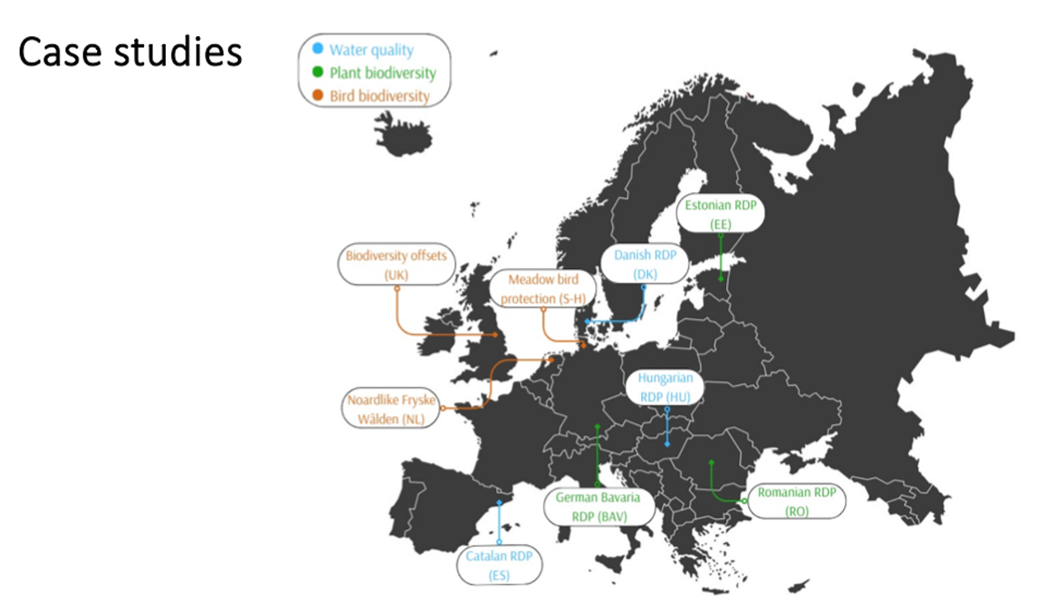

Slide 15
AES features assessed in our 9 case studies
AES features | NL | RO | BAV | S-H | UK | HU | DK | ES | EE
Individual vs. collective schemes | X |  |  |  |  | X | X
Result- vs. action-based/ hybrids | X | X | X | X |  |  | X
Investment in environmentally friendly technologies |  |  |  |  |  | X |  | X
Performance of ES/biodiversity markets |  |  |  |  | X |  | X
Farmer preferences and adoption | X | X | X |  |  | X | X | X | X
Institutional set-ups | X | X | X | X |  | X |  | X | X
Role of intermediaries | X |  |  | X
Transaction costs | X |  |  |  |  | X
Dependence on ecological/landscape conditions |  |  | X |  | X |  | X |  | X
Environmental efficiency |  |  | X |  |  | X | X
Cost effectiveness | X |  | X |  | X |  | X
ES & biodiversity metrics in programme design |  |  |  |  | X |  | X |  | X
Spill-over effects on other ES/biodiversity targets |  |  |  |  | X |  | X

Slide 16
Case lessons vis-A-vis our theory of change
INPUTS
TREATMENTS
OUTPUTS
OUTCOMES
IMPACTS
Institutional needs
Conditional incentive design
Farmers participate at adequate scale
Ex-ante additionality may produce adverse selection/no-engagement of most intensive farmers (BAV, RO, UK)
AES recipients adopt desirable agricultural practices/ actions
Internal coordination mechanisms in collective incentives can improve performance (NL)
Trust building can increase confidence and uptake in RBS (BAV, RO)
ES benefits enhanced vis-à-vis baseline (targets reached)
Ecological efficiency for honeybees requires a low-diversity forage mix (EE)
Low eco-efficiency in dairy farms: difficult to achieve balance btw. competitiveness and public good provision (BAV)
Legal-admin framework
Grassroot initiatives enabled trust building (S-H, NL)
Flexibility in management prescriptions increases uptake (BAV, RO, NL, S-H)
Inclusiveness in design process influences uptake (NL, UK, ES)
AES intermediaries
Provide training and info meetings to clarify contract requirements improve uptake (NL, RO, S-H, ES, UK)
Financing sources
RBS preferred when outcome is achievable. Risk of adverse self-selection (BAV)
Hybrid RBS-ABS may increase uptake (BAV, NL, S-H)
Bonuses can increase participation of reluctant farmers & reduce overall costs (NL, DK)
Collective AES with peer reward & exclusion threats showed good performance (DK)
Farmers understand/ accept treatment(s)
Collective schemes may contribute to distribute risk & increase engagement (NL)
Changes range from land cover and use to production inputs and practices
Spatial targeting is key but should be tailored to the ES at stake (RO, DK, EE)
Supported farmer opportunity costs and rural development vis-à-vis baseline
Marginal role played by AES in farm economy in intensive systems (BAV)
Farmers change attitudes
Complements
Farm incomes well- supported
Contextual knowledge

Slide 17

Scheme design and participation
Farmer uptake depends on flexible contracts & alignment of AES requirements with farming practices…
…but excessive alignment reinforces adverse self-selection biases, leading to low AES additionality
Intensive farmers have higher opportunity costs: less likely to take up AES regardless of design
Add-on features might persuade more farmers to enroll:
- additional ‘carrots’ (e.g., bonus payments),
- potential ‘sticks’ (e.g., exclusion or regulatory threats)
- peer pressures (e.g., in collective schemes).

Slide 18


Action- vs. result-based contracts
Paying for actions
  Preferred by farmers for the secure payment
  Convenient in watershed AES (ES uncertainty & costly to measure)
Paying for results
  Preferred by environmentally inclined & extensive farmers
  Sometimes implementable in biodiversity AES
Hybrid AES (mixing payments for actions and results) are quite promising

Slide 19

Other AES design features
Differentiating AES payments: higher incentives for conserving most valuable and/or most threatened sites in a landscape, rewarding pre-compliant farmers while also betting towards additionality
Spatial targeting: essential for improving environmental quality also in intensive farming systems → Locally adapted through regional AES
Combining multiple outcomes could maximise the environmental gains, but is complex: more intricate management prescriptions, increased coordination and commitment by farmers → more feasible in smaller schemes

Slide 20

When will AES deliver on their goals?
 |  | Meet desired AES conditions without payment?
 |  | No | Yes
2. Apply for AES payment? | No | Too high opportunity costs BAV, NL, UK, ES, DK, HUN | Intrinsic motivation NL, RO
 | Yes | Additionality S-H, EE, NL, DK, UK | Adverse selection bias BAV, RO, UK, NL
Inspired from the PES literature: Persson & Alpizar (2013)

Slide 21
Success measures Contracts features | Farmer uptake | Farmer welfare | Environmental impact | Cost-effectiveness
Action-based | Secure payment | Predictable income | Indirect link to ES | Less ES delivered Low-cost monitoring
Result-based | Higher risk More flexible management | More effort & risk Local knowledge integrated | Direct link to ES | More ES delivered Expensive to monitor
Individual scheme | More predictable | More predictable rise, individualism | Low ES contiguity | More contracts, more transaction costs
Collective scheme/ participation bonuses | Transaction costs added vs bonus paid | Joint coordination, bonus paid but free-riding risk | High ES contiguity | Fewer contract costs Bonus costs. Higher costs for collectives
Spatial targeting of eligible farmers | Fewer farmers participate | Some farmers not eligible – can be perceived as unfair | Increased ES | More value for money Added targeting costs
Differentiated payment mechanisms | Agency co-determines uptake | Reduced rents | Increased ES | More value for money Added targeting costs

Slide 22

How much (A)ES ‘bang for the buck’?
Most empirical case-study research in middle part of ToC, i.e. from treatments to outputs (e.g. farmer participation), and sometimes outcomes (e.g. land-use changes)
Very few ‘hard’ ex-post impact evaluations of environmental or socio-economic effects (those we have, with mixed record)
-> How much do ‘we’ (as society) really want to know about the environmental bottom line of AES?

Slide 23

Thank you!
sven.wunder@efi.int

Slide 24
PRINCIPLES for designing effective eco-system service delivery measures
Giulia Bazzan (KU), Jeroen Candel (WUR), Carsten Daugbjerg (KU)
WP 3 - Institutions

Slide 25
TYPES OF ECO-SYSTEM SERVICE DELIVERY MEASURES
 | ACTION-BASED | RESULTS-BASED
INDIVIDUAL | Least successful type | Intermediate
COLLECTIVE | Intermediate | Most successful type

Slide 26
TYPES OF ECO-SYSTEM SERVICE DELIVERY MEASURES
 | ACTION-BASED | RESULTS-BASED
INDIVIDUAL | Catalan case (unsuccessful), Estonian case (unsuccessful) | Romanian case (successful), Bavarian case (successful), Hungarian case (unsuccessful)
COLLECTIVE | Dutch case (successful)

Slide 27
HOW SUCCESSFUL ARE ECO-SYSTEM SERVICE DELIVERY MEASURES?
 | High capacity to overcome barriers | Low capacity to overcome barriers
Uptake increased (or very high) | Dutch case, Romanian case | Bavarian case (intermediate capacity)
Uptake decreased (or very low) |  | Hungarian case, Catalan case, Estonian case
Notes:
We classified our case studies according to two dimensions that emerged both from the literature and from our interviews as relevant indicators of successful outcomes in agri-environmental schemes: farmers’ uptake on one hand and capacity to overcoming barriers on the other

Slide 28
SUCCESSFUL INDIVIDUAL RESULTS-BASED AES
A result-based grassland conservation scheme targeting plant species conservation has recently been initiated as part of the regional agri-environment program in the state of Bavaria, in Germany. Farmers signing up are paid if a number of predefined plant species were found ex post on their land. The results-based scheme is being piloted during the programming period 2015-20.
A pilot AES was running in Romania between 2015 and 2019, led and implemented by the non-governmental organization ADEPT Foundation, and financed by DG Environment and Deutsche Bundesstiftung Umwelt (DBU). Thirty species have been selected and tested as biodiversity indicators of high nature value meadows in the pilot scheme regions. Individual farmers uptaking the scheme are paid by results of measured species diversity on their farms and have the freedom to choose management practice according to local conditions.

Slide 29
SUCCESSFUL COLLECTIVE ACTION-BASED aes
The Dutch Rural Development Program finances a wide variety of measures, mainly concerning restoration, conservation, and enhancement of ecosystems related to agriculture. The program has a strong ecological perspective and aims at promoting biodiversity and improving water and soil management. Within this framework, the Dutch agricultural landscape management scheme evolved under the 2014 EU Rural Development Regulation, which introduced the option of group applications for agri-environment-climate measures (Regulation EU 1305/2013, Art. 28). As a result, since 2016, only joint applications (through agrarian/nature collectives) became eligible for subsidies for agri environmental management. The agrarian collective submits a territorial application that specifies which agri-environmental activities the collective (and its members) will perform in their territory, and how these will contribute to the realization of the goals of the provincial nature management plan. Collective subsidies will be granted only after the province has approved the territorial application.

Slide 30
HOW ARE AES DESIGNED?
Case | Participation in design | Role definition | Flexibility | Bottom-up or top-down | Knowledge exchange
Catalan | Stakeholder consultation | Clearly defined, no overlapping | Rigid implementation | Top-down | Information provided through technical offices
Estonian | Limited involvement through working groups | Clearly defined, no overlapping | Rigid implementation | Top-down | Full information and training provided; collaboration
Hungarian | Limited stakeholder involvement | Clearly defined, no overlapping | Rigid implementation | Top-down | No information provided; no collaboration

Slide 31
HOW ARE AES DESIGNED? (ii)
Case | Participation in design | Role definition | Flexibility | Bottom-up or top-down | Knowledge exchange
Romanian | Stakeholder consultation | Clearly defined, no overlapping | High flexibility in implementation | Bottom-up | Full information and training provided; collaboration
Bavarian | Stakeholder consultation | Clearly defined, no overlapping | Rigid implementation | Top-down | Full information but limited advice; no collaboration
Dutch | Stakeholder consultation | Clearly defined, no overlapping | High flexibility in implementation | Bottom-up | Full information and training provided; collaboration

Slide 32
HOW EFFECTIVE IS THE DESIGN OF ECO-SYSTEM SERVICE DELIVERY MEASURES?
 | INCLUSIVE DESIGN PROCESS |  | NON-INCLUSIVE
 | FLEXIBLE IMPLEMENTATION | NON FLEXIBLE | FLEXIBLE | NON FLEXIBLE
HIGH KNOWLEDGE EXCHANGE | Dutch case Romanian case |  |  | Estonian case
LOW KNOWLEDGE EXCHANGE |  | Bavarian case |  | Hungarian case Catalan case
Notes:
We identified combinations of different design conditions that are relevant for successful agri-environmental schemes: collaboration among participants, inclusive design process, flexible implementation

Slide 33
CONCLUDING REMARKS
Empirical contribution → Wide diversity in design and implementation success
Theoretical contribution → Implications of intermediate conditions
Methodological contribution → Configurational comparative approach
Practice contribution → policy brief
Potential further research → collective results-based measures, expanding population of cases, investigating other conditions

Slide 34
CATEGORIES

Slide 35

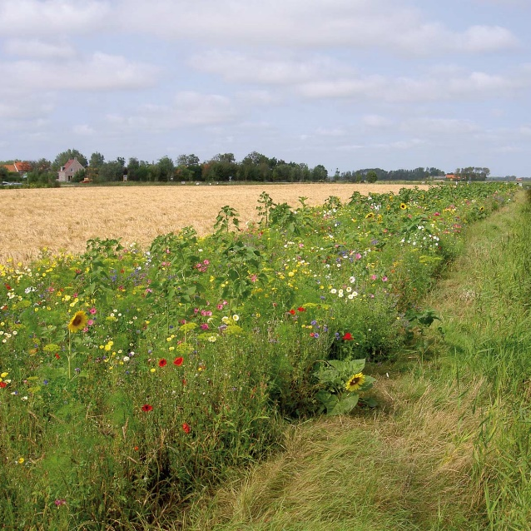



The collective scheme in the Netherlands
Final event EFFECT, 4 October 2023
Liesbeth Dries, Wageningen University

Slide 36
Introduction
Criticism on agri-environmental schemes (AES) for being ineffective when it comes to creating landscape-level ecosystem services (for instance, landscapes attracting migratory birds)

Slide 37
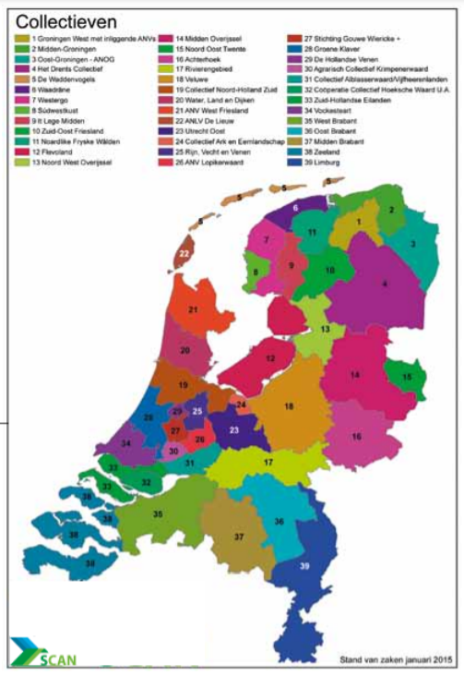
Since 2016, AES are implemented through 40 collectives in the Netherlands

Slide 38
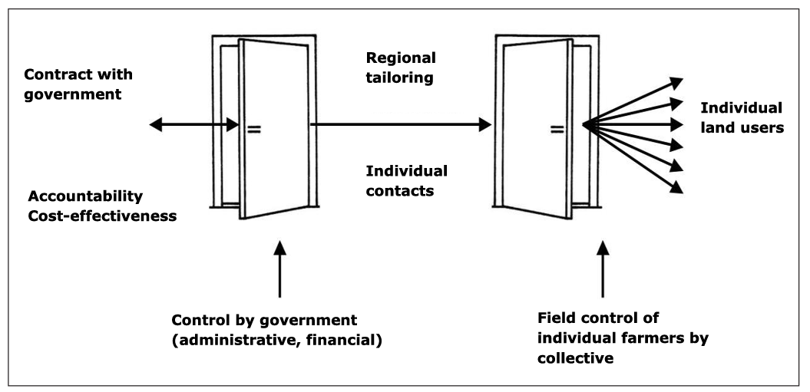
The front-door back-door approach
Collectives
Notes:
Collectives are legal entities that contract on the one hand with the provincial government and on the other with farmer-members.

Slide 39
AES collectives as spatial coordinators
Farmer collectives in the NL form an integral part of the AES system as spatial coordinators:
  They identify areas within the collective’s territory that are best suited for bird conservation (based on local knowledge)
  Only the farmer-members in this area are invited to participate in the meadow birds AES
  A diversity of landscape elements (ponds, hedges, herb-rich grassland...) attracts more birds; farmers receive different payments for different elements; the collective coordinates this
Notes:
FOCUS on bird conservation!

Slide 40
AES collectives as spatial coordinators
Spatial coordination for meadow birds – the “mosaic”, implemented by farmer collectives on fields of member-farmers
Feeding areas
(field flooding)
Resting areas
(herb-rich)
Light measures
(nest protection)

Slide 41
Insights from the EFFECT project
On effectiveness…
On transaction costs…
On participation in result-based versus action-based schemes…
  … in the context of AES collectives

Slide 42
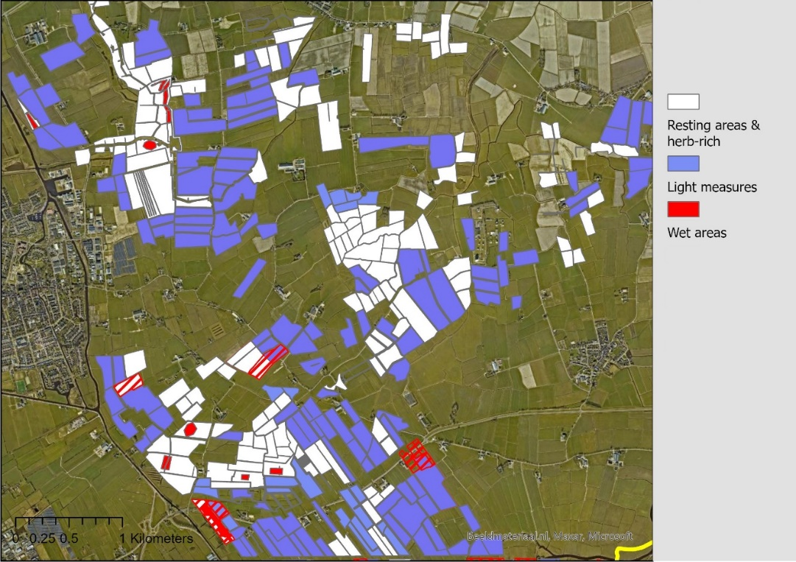
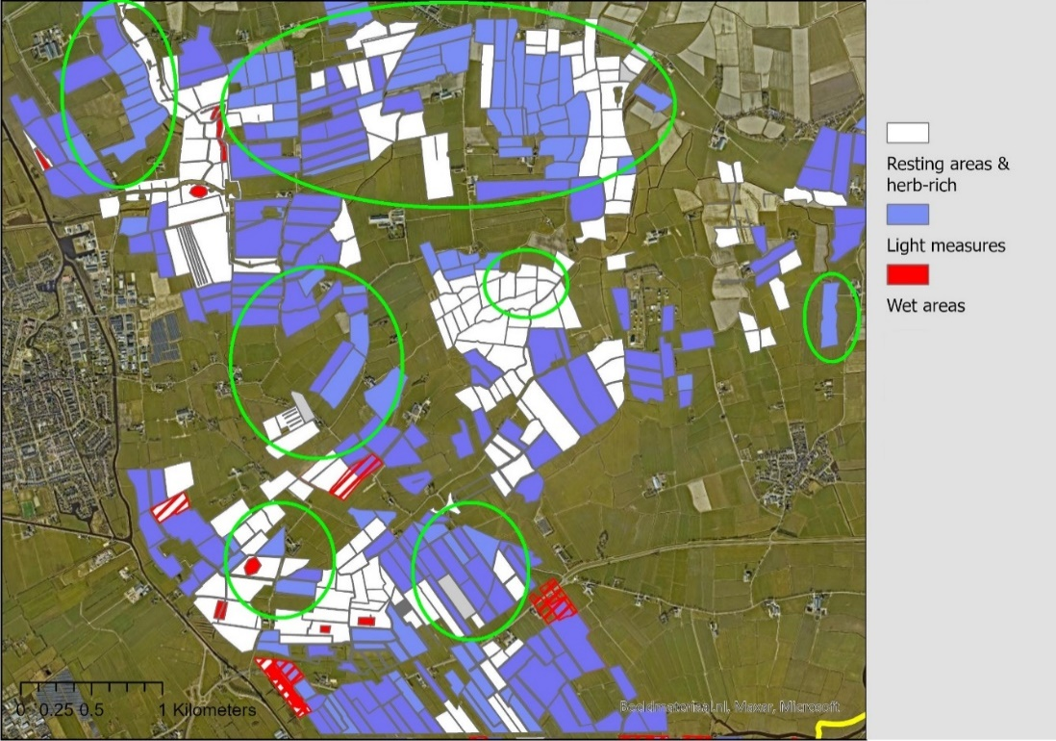
Effectiveness of AES collectives
Mosaic A of the collective NFW in 2016
Mosaic A of the collective NFW in 2021
Source: Dries and Splinter (2023)
Notes:
Focus on NFW territory
GIS data of areas with AES contracts – and indicating the specific measures that are taken

Slide 43
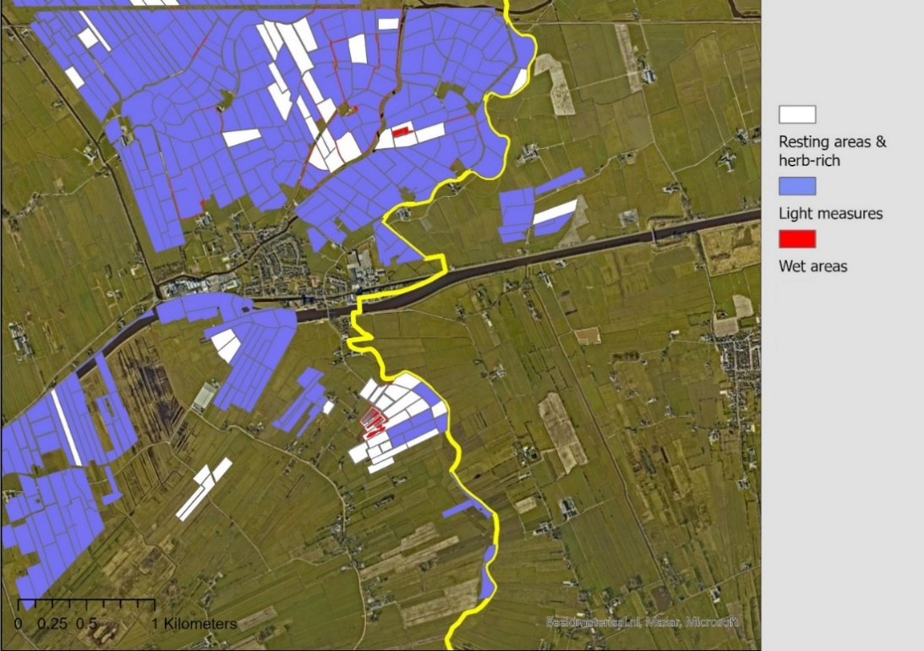
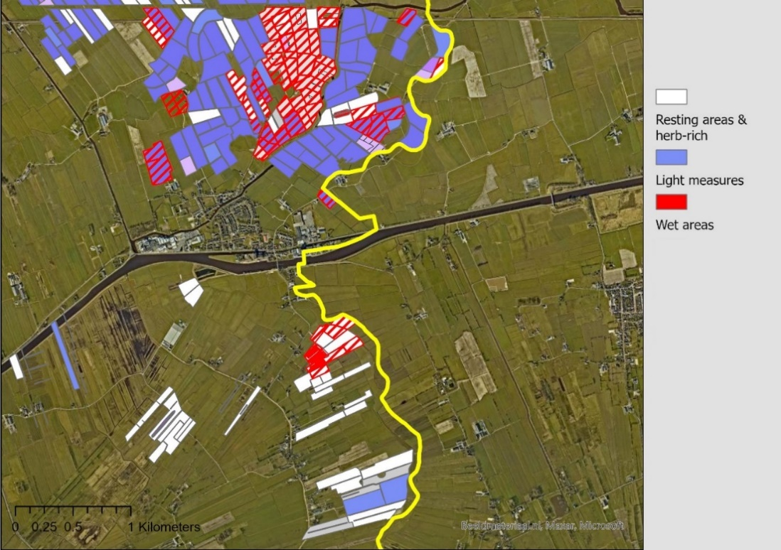
Effectiveness of AES collectives
Mosaic B&C of collective NFW in 2015
Mosaic B&C of collective NFW in 2021
Source: Dries and Splinter (2023)
Notes:
Focus on NFW territory
GIS data of areas with AES contracts – and indicating the specific measures that are taken

Slide 44
Transaction costs (TC) in the collective scheme
The transition from the individual to the collective AES has shifted TC from public actors to collectives (overall TC may have increased or decreased)
The success of the collective approach depends on the efforts of volunteers in the field (TC not reported)
The collective approach is strongly embedded in rural areas in the Netherlands. This may have implications for the replicability to other contexts.
Source: Splinter and Dries (2023)

Slide 45
Result-based versus action-based AES
Preference for hybrid over a purely result-based scheme
  b/c uncertainty (predators, weather…) and the need for different types of measures (actions)
A hybrid contract was tested including:
  Collective bonus paid out if bird counts of the collective exceed the regional average
  Individual bonus for farmers for specific measures
Results: Collective bonus can increase focus on results, but bonus needs to be high
Source: Thiermann et al. (2023)

Slide 46
Thank you for your attention!
To explore
the potential
of nature to
improve the
quality of life

Slide 47
References
Dries, L. and M. Splinter, 2023. “Coordinating the implementation of environmental policies for biodiversity: The agri-environmental collectives in the Netherlands”, submitted to Journal of Institutional Economics.
Splinter, M. and L. Dries, 2023. “A conceptual framework for measuring transaction costs in agri-environmental schemes: an application to the Dutch collective scheme”, Journal of Environmental Planning and Management, https://doi.org/10.1080/09640568.2023.2218989
Thiermann, I., Silvius, B., Splinter, M. and L. Dries, “Making bird numbers count: Would Dutch farmers accept a result-based meadow bird conservation scheme?”, Ecological Economics, 214, https://doi.org/10.1016/j.ecolecon.2023.107999

Slide 48
Result-Based Schemes in Bavaria, Germany
Philipp Mennig & Carolin Canessa, Technical University of Munich

Slide 49
Novel Design Mechanisms – Overview
Collectively organized nature conservation
Payment by results: rewarding farmers for conservation outcomes rather than activities
Conservation auctions: allocate contracts through competitive bidding
Spatial coordination of conservation activities
Social norms interventions: Securing environmental gains in the long run

Slide 50

Introduction
(Theoretical) advantages of result-based schemes compared to action-based approaches:
(1) encourage farmers to innovate to produce environmental goods
(2) ensure that farmers are paid for provision of environmental services rather than for performing management practices
(3) raise the intrinsic interest of farmers in achieving environmental objectives (social capital)
(5) provision of ecosystem services becomes an integral part of the farmers’ systems and businesses
(4) provide opportunities for individual, flexible and site-specific solutions
(6) potentially achieve environmental improvements at lower public and private costs

Slide 51
Case Study: Result-Based Conservation of Species Rich Grassland in Bavaria
Since 2015, the Federal State of Bavaria offers a result-based measure aiming at maintaining species rich grassland as part of the Bavarian Cultural Landscape Program (Kulturlandschaftsprogramm - KULAP)
1,193 Mio €
4 priorities
The KULAP
2014-2020(22):
A brief overview
Budget
Biodiversity + Soil and water +
Climate + Cultural landscape
33
~ 50,000
Different measures
Participating farmers

Slide 52
Case Study: Result-Based Conservation of Species Rich Grassland in Bavaria
Cattle grazing scheme
Low emission manure application
Flower strip scheme
KULAP: Broad variety of options from animal welfare measures to landscape diversity measures

Slide 53
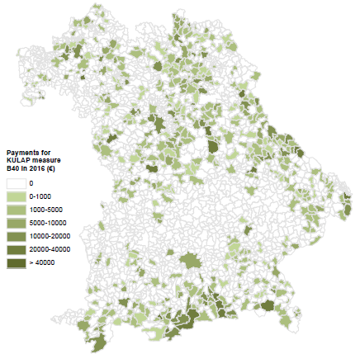
Case Study: Result-Based Conservation of Species Rich Grassland in Bavaria
2015
2016
2017
2018
Farmers receive 250
€/ha if they can prove
that at least 4
predefinded grassland
species can be found on their fields.
894
858
845
897
participating
farmers
participating
farmers
participating
farmers
participating
farmers
1,389,514
1,306,596
1,268,601
1,351,581
€ spent
€ spent
€ spent
€ spent
Uptake rates are low
(comparable action-based measure has
8,084 participating
farmers).
5,074 ha
5,406 ha

Slide 54
Emerging Questions
Effectiveness of existing schemes
What do we know about the economic and ecological performance of action-based schemes?
Adoption of existing schemes
What are crucial factors when it comes to farmers‘ adoption of action-based schemes?
Effectiveness of result-based schemes
How do result-based schemes perform economically and ecologically compared to action-based schemes?
Adoption of result-based schemes
How do farmers perceive result-based agri-environment schemes?

Slide 55
Effectiveness of Existing Schemes
Methods
Empirical cases
Main results
Data Envelopment Analysis with desirable technology and accompanying undesirable by-production technology to measure farm-level environmental/ecological and economic efficiency/productivity
Ex-post quasi-experimental econometric treatment effect tools to measure scheme effects
Spatial econometrics
Bavarian dairy farms surveyed between 2013 and 2018
Dairy and crop farms from Germany, Italy, France, the Netherland surveyed between 2006 and 2011 (FADN)
Municipality-level data on scheme participation and groundwater quality in Bavaria
Agri-environment schemes do not alter farms’ economic and environmental efficiency nor green productivity
Eco-efficiency scores do not vary significantly between AES participants and non-participants, which questions the effectiveness of present AES
AES focusing on crop production, organic farming, cultural land-scape do not improve groundwater quality
Papers
Ait Sidhoum, A., Canessa, C., Sauer, J. (2023). Effects of agri-environment schemes on farm-level eco-efficiency measures: Empir-ical evidence from EU countries. Journal of Agri-cultural Economics, 74(2), 551-569.
Ait Sidhoum, A., Mennig, P., Sauer, J. (2023). Do agri-environment measures help improve environmental and economic efficiency? Evidence from Bavarian dairy farmers. European Review of Agricultural Economics, 50(3), 918–953.
Tzemi, D., Mennig, P. (2022). Effect of agri-environment schemes (2007–2014) on groundwater quality; spatial analysis in Bavaria, Germany. Journal of Rural Studies, 91, 136-147.
Ait Sidhoum, A., Mennig, P., Frick, F. (2023). Assessing the Impact of Agri-Environmental Payments on Green Productivity in Germany. Under Review.

Slide 56
Adoption of Existing Schemes
Method
Cases
Main results
Systematic review of 20 years of ex-post empirical studies on AES adoption
Different constructs, grouped into ‘alignment’, ‘opportunity’, ‘engagement’, and ‘contracting’ are considered to investigate how they influence farmer decisions
European agri-environment schemes
Large contextual diversity in farmer decisions to participate
Variables explaining the relevance of AES to farmers, the role of social contexts and satisfaction with contract design are the most significant ones
Variables explaining the opportunity of participation are mostly ineffective in explaining uptake
Paper
Canessa, C., Ait Sidhoum, A., Wunder, S., Sauer, J. (2023). Understanding farmers’ participation in European agri-environmental measures: a systematic review of the quantitative literature. Under Review.

Slide 57
Effectiveness of result-based schemes
Methods
Empirical case
Main results
Economic-ecological model to evaluate how efficient are farms participating in action and result-based schemes when marketable and non-marketable outputs are produced
Data Envelopment Analysis to estimate farms' environmental efficiency in the production of marketable outputs and ecological services and to derive shadow prices of biodiversity
Representative sample of Bavarian dairy farms managing a large share of permanent grassland in Bavaria (survey in 2022)
Sample includes farms participating in result-based grassland conservation scheme, farms participating in action-based grassland conservation scheme and non-participating farms
Farm-level biodiversity indicator based on grassland species found on fields
Result-based schemes perform better than action-based schemes when it comes to the joint production of milk and biodiversity
Opportunity costs of biodiversity provision with result-based schemes are higher compared to those of action-based schemes
Paper
Canessa, C., Raab, F. X., Mennig, P., Sauer, J. (2023). Opportunity costs of providing biodiversity in dairy farming: comparing result-based and action-based payments for grass-land conservation in Bavaria. Working paper.

Slide 58
Adoption of result-based schemes
Methods
Empirical case
Main results
Discrete Choice Experiment to investigate farmers' preferences for alternative grassland biodiversity payments
Farm ecological performance is measured using a biodiversity index built based on grassland species found on fields
Representative sample of Bavarian dairy farms managing a large share of permanent grassland in Bavaria (survey in 2022)
Sample includes farms participating in result-based grassland conservation scheme, farms participating in action-based grassland conservation scheme and non-participating farms
Farm-level biodiversity indicator based on grassland species found on fields
Farmers are more reluctant to accept action-based schemes, however, the payment mechanism is not the only driver of farmers' decision-making
Applicability of the prescribed management practice to the farming system, and the achievability of the outcome, are also key for adoption
Intensive farmers are more likely to choose hybrid solutions than extensive farms, which prefer a result-based approach
Farms with higher biodiversity tend to accept result-based schemes more frequently and are willing to enrol a greater share of their land
Paper
Canessa, C., Venus, T. E., Wiesmeier, M., Mennig, P., Sauer, J. (2023). Incentives, Rewards or Both in Pay-ments for Ecosystem Ser-vices: Drawing a Link Be-tween Farmers' Prefer-ences and Biodiversity Levels. Ecological Econom-ics. Forthcoming.

Slide 59

Conclusion
Traditional (action-based) schemes perform rather poorly concerning environmental benefits; joint economic-ecological modelling leads to similar results
Action-based schemes do not encourage farmers to improve their environmental efficiency nor do they improve green productivity
Additionality of schemes is difficult to measure as many farms have a long history in participating in schemes and as farm-level environmental data is difficult and costly to obtain
Action-based schemes remain popular; main criteria for farmers to participate are still the possibility to easily integrate it into farm management and detailed knowledge about the scheme
While the theoretical advantages of result-based schemes are well-known by farmers, they are not the only drivers behind joining or not; hybrid schemes might be a solution
Some evidence that result-based schemes perform better than action-based schemes when it comes to the joint production of marketed and non-marketed goods
Foto: Peta

Slide 60



Hybrid Agri-Environmental-Climate Schemes:
Farmers’ Preferences for Practices
and Outcomes.
Final event EFFECT, 4th October 2023
Carolin Canessa
Technical University of Munich – TUM
*Contact: carolin.canessa@tum.de

Slide 61

Introduction
Agri-Environmental-Climate Schemes (AECS) are voluntary payments made to farmers:
  Implementing specific management practices (Action based)
  Achieving predefined environmental outcomes (Result based)
Ongoing discussion:
Is it better to pay farmers for actions or results? Or both?

Slide 62
Conceptual framework
Result-based schemes more efficient than action-based ones with information assymetry
(Gibbons et al. 2011; White and Hanley 2016).
Advantages
Disadvantages
  Management flexibility.
  Land enrolled is additional.
  Production of environmental services integral part of farming.
  Link between payment and result.
  Risk of non-achievement shifted from regulator to farmers.
  Increased monitoring and transaction costs.
Drawbacks affecting adoption
Hybrid approaches to overcome these limitations
(Matzdorf et al. 2010; Burton and Schwarz 2013; Derissen and Quaas, 2013)

Slide 63
Research approach
Objective
Contribute to the discussion on whether is better to pay farmers for actions or results, or both (focus on participation).
Method
Used a Discrete Choice Experiment (DCE) in the case study of Bavaria (Germany) to:
  Q1. Investigate farmers’ preferences for alternative contract designs (result, action, hybrid);
  Q2. Link preferences to farm structural and ecological characteristics.

Slide 64

Methods
Case study
Federal State of Bavarian (DE)
Grassland: 35 % UAA
Different approaches exist (KULAP 2015-2022) for grassland biodiversity:
  Action based measures - i.e.
    Late mowing (Ban before 1° July)
    Limit to livestock density (Max 1.4 LSU/ha)
  Result based measure
    4 flowering species out of a list of 34 species
    Farmers do their own monitoring

Slide 65
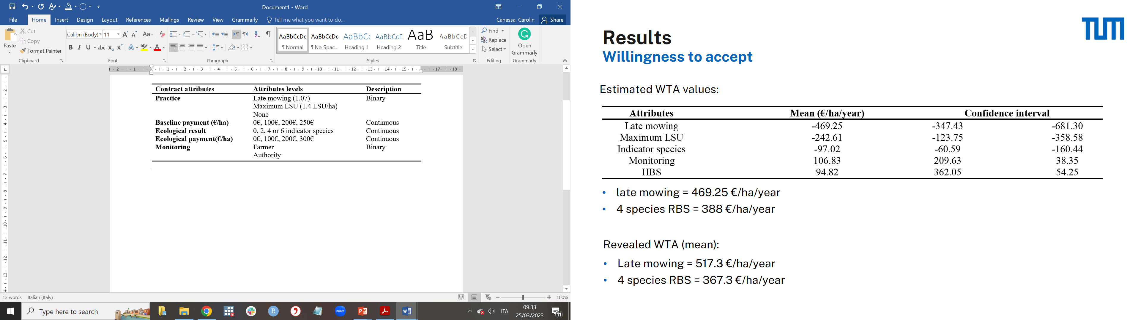
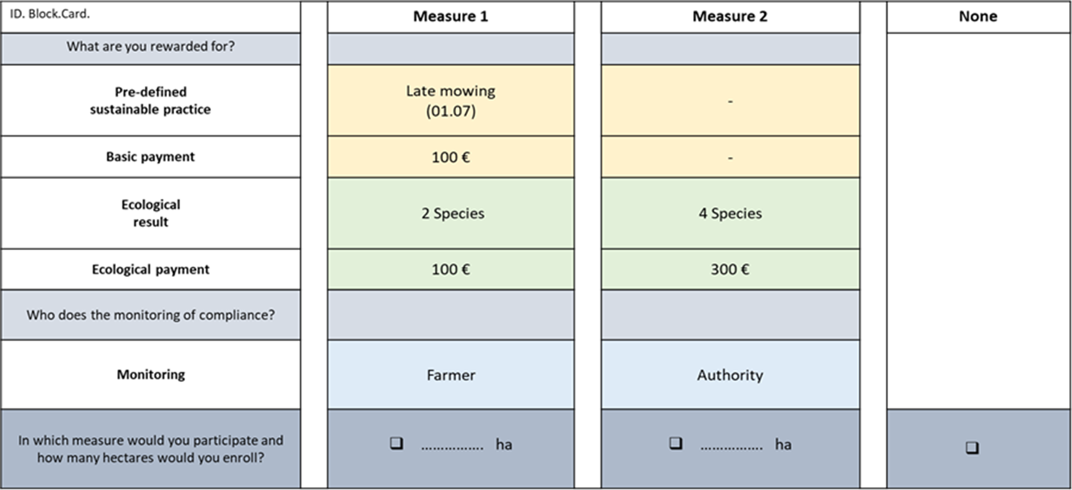
Attribute selection based on:
KULAP offer
Q-methodology
Methods
Experimental
design
Combination of attibutes determines the approach:
Action (ABS)
Result (RBS)
Hybrid (HBS)

Slide 66
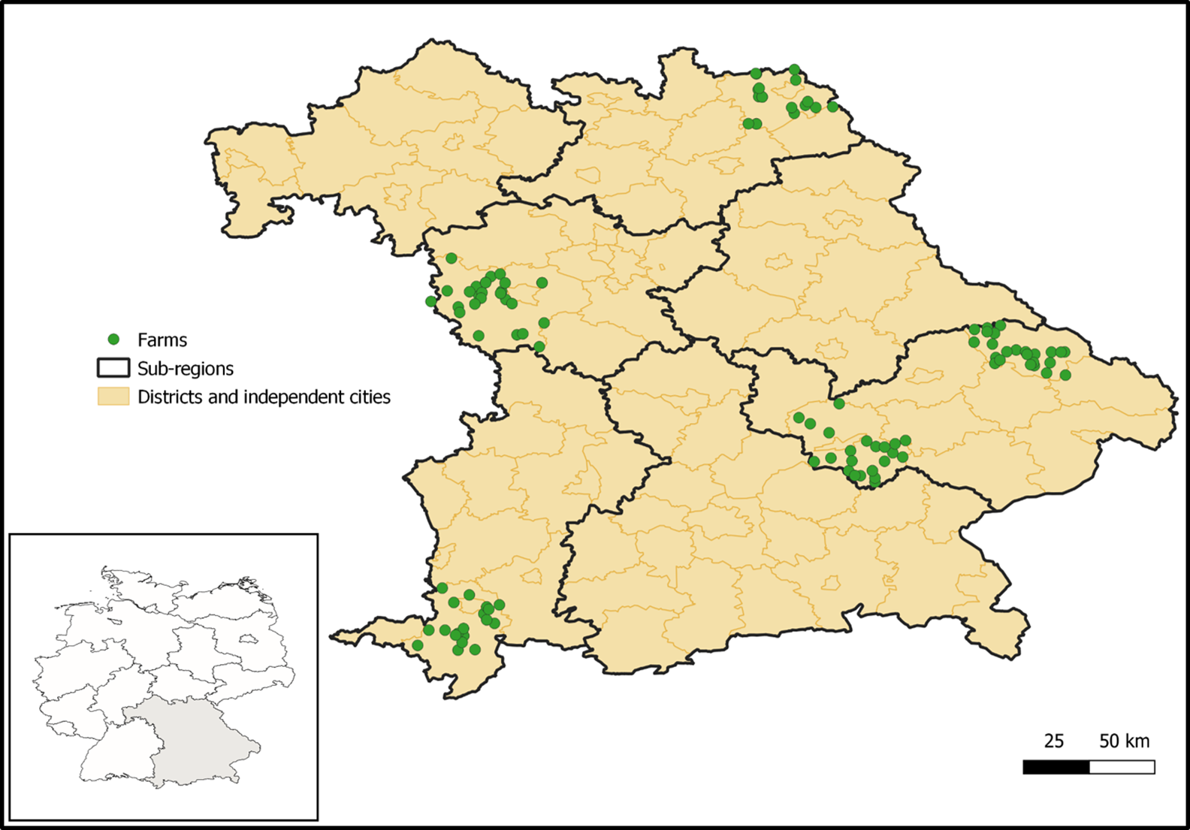
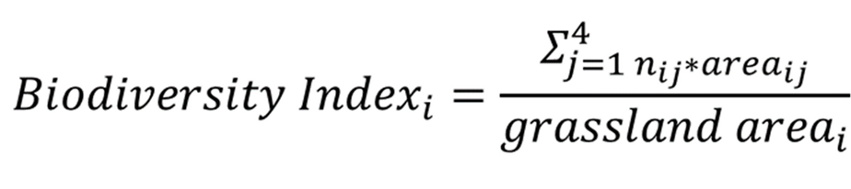
Methods
Data collection
In person data collection.
Sample of 107 grassland farms.
Farm structural data
Farm ecological data
  Species richness recorded plot level.
  Farm level biodiversity index:

Slide 67
Methods
Analytical framework
Three steps approach:
Mixed logit (Train, 2009): to estimate probability of a farmer adopting the scheme as a function of the contract attributes, scheme approach and ecological status of farms.
Latent class (Boxall and Adamowicz, 2002): to estimate how the probability of uptaking the schemes vary among groups of farmers with different farm structures.
Land allocation analysis (Kuhfuss et al., 2016): to estimate the effect of attributes and ecological status on land allocation decisions.

Slide 68
Results
Mixed logit

Slide 69
Results
Intensive
Extensive
Latent class

Slide 70
Results
Land allocation decision

Slide 71
Discussion & Conclusions
Q. | Findings | Implications
1. | No clear preference for any approach. Overall rejection action-based schemes. Payment mechanism is not the only driver of farmers’ choices. Applicability of practices, achievability of outcomes, and farm structure better explain preferences. Some practices make farming impossible. | Targeting farmers and tailor payments based on scheme's primary objectives. Offer both type of schemes: HBS to induce extensification by intensive farms. RBS to induce maintainance by extensive farms.

Slide 72
Discussion & Conclusions
Q. | Findings | Implications
2. | Farms with higher biodiversity tend to accept RBS more frequently, and are willing to enrol a greater share of their land. Awareness about farms’ ecological potential influences uptake of RBS. | Need to consider a potential lack of additionality: Baseline measures for schemes aiming at modifying practices. No need of baseline measures for schemes aiming at maintaining practices. On-site technical advice to help farmers assessing their plots’ ecological potential.
Need for replication studies for external validity.

Slide 73
Thank You
For Your Attention
Carolin Canessa
Technical University of Munich
carolin.canessa@tum.de
For further information:
Canessa, C.; Venus, T. E.; Wiesmeier, M.; Mennig, P.; Sauer, J. (2023): Incentives, rewards or both in payments for ecosystem services: Drawing a link between farmers' preferences and biodiversity levels. In Ecological Economics, 213, 107954. DOI: 10.1016/j.ecolecon.2023.107954

Slide 74
Appendix
References
Boxall, Peter C.; Adamowicz, Wiktor L. (2002): Understanding Heterogeneous Preferences in Random Utility Models: A Latent Class Approach. In Environ Resource Econ 23 (4), pp. 421–446.
Burton, Rob J.F.; Schwarz, G. (2013): Result-oriented agri-environmental schemes in Europe and their potential for promoting behavioural change. In Land Use Policy 30 (1), pp. 628– 641.
Derissen, Sandra; Quaas, Martin F. (2013): Combining performance-based and action-based payments to provide environmental goods under uncertainty. In Ecological Economics 85, pp. 77–84.
Gibbons, James M.; Nicholson, Emily; Milner-Gulland, E. J.; Jones, Julia P. G. (2011): Should payments for biodiversity conservation be based on action or results? In Journal of Applied Ecology 48 (5), pp. 1218–1226.
Kuhfuss, Laure; Préget, Raphaële; Thoyer, Sophie; Hanley, Nick (2016): Nudging farmers to enrol land into agri-environmental schemes: the role of a collective bonus. In European Review of Agricultural Economics 43 (4), pp. 609–636.
Matzdorf, Bettina; Lorenz, Jana (2010): How cost-effective are result-oriented agrienvironmental measures?—An empirical analysis in Germany. In Land Use Policy 27 (2), pp. 535–544.
Train, Kenneth E. (2009): Discrete Choice Methods with Simulation. 2nd ed. Cambridge: Cambridge University Press
White, Ben; Hanley, Nick (2016): Should We Pay for Ecosystem Service Outputs, Inputs or Both? In Environ Resource Econ 63 (4), pp. 765–787.

Slide 75

Rewarding landowners for biodiversity improvements: payments for actions or payments for outcomes?
Katherine Simpson¹, Mary Nthambi¹ Frans P. de Vries², Paul R. Armsworth³, Martin Dallimer^{4,} and Nick Hanley ¹
1. School of Biodiversity, One Health & Veterinary Medicine, University of Glasgow 2. Business School, University of Aberdeen
3. Department of Ecology and Evolutionary Biology, University of Tennessee 4. Faculty of Environment, University of Leeds

Slide 76

What to pay for?
Majority of AES currently focus on payment for actions e.g., reduced fertilizer use, lower stocking rate.
  AES which pay for environmental results are being increasingly discussed in the academic literature and policy circles in Europe and the UK

Slide 77
Payment for Results
  Value of the payment directly linked to the level of environmental outcomes achieved, not to the management inputs/actions undertaken
  Theoretically preferable for a number of reasons:
    Farmers can use private information to determine how best to produce these outcomes
    Provide incentives to farmers to enrol their most suitable land and reduces adverse selection (White and Hanley 2016)
    By being less prescriptive and by rewarding inventiveness, they may increase farmer engagement and lead to an internalization of the scheme’s goals by farmers (Burton and Schwarz, 2013).
    Why, then, are result-based schemes not more prevalent?

Slide 78
Payment for Results
    Why then are result-based schemes not more prevalent?
    Less attractive to farmers due to the associated uncertainty of payment, as performance also depends on external environmental effects (for example the weather; the behaviour of neighbours; migration patterns)
    Can require sophisticated monitoring and measurement of results
    Schemes have only been applied in contexts where monitoring costs and payment uncertainty are acceptably low

Slide 79
Payment for modelled results
Suggested in paper by Bartkowski et al (2021)
Farmers enter into a contract where their payments depend on the predicted results of their actions on some indicator (eg species presence versus absence; water quality change)
These predictions come from a statistical model relating actions to outcomes
Advantages to the farmer: no uncertainty over the payment (compared to payment for actual results)
Advantages to the government: differentiates payment rates according to spatially-varying ecological benefit; lower monitoring costs than pure payment-for-results.

Slide 80

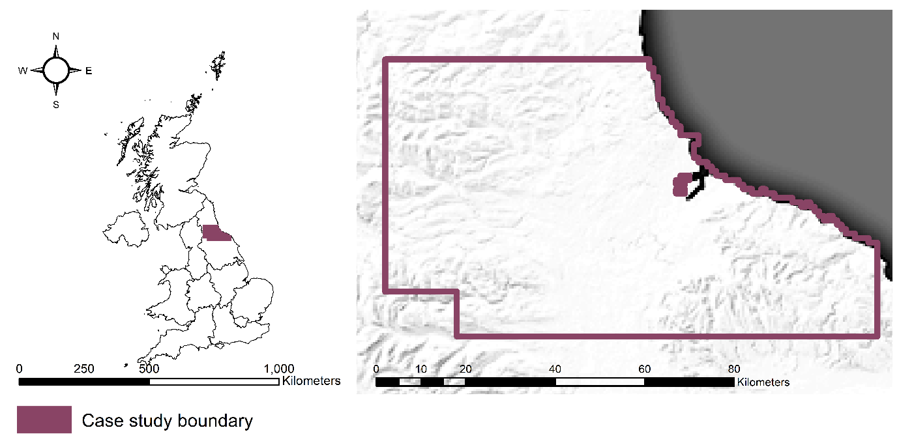
Case study: Lapwing Conservation in the Tees Valley & Pennine Uplands

Slide 81
Theoretical Framework
  Economic decisions modelled based on the economic rent (profit) generated by each land parcel
  For a farmer to switch from ag. production to conservation, farmer must be offered a subsidy payment equal at minimum to the agricultural rent forgone
  Gross margin (rent) of ag. parcels calculated by combining crop coverage & livestock stocking rates with the associated gross margin data
  We expect agricultural rents to vary across the landscape (soil quality, altitude, rainfall patterns)
  Ecological outcomes based on species responses to change in agricultural land management practices

Slide 82
Policy simulation
  Payment for actions: no spatial targetting
  Farmers are paid to undertake actions to restore low intensity grassland (Equivalent to the dominant type of contract under Pillar 2 of the CAP)
  Subsidy paid to farmers based on the average opportunity cost per ha of restoring agricultural land to low-intensity grassland across the catchment
  Uniform payment rate: £585 per hectare (all farmers are offered this amount)
  Total subsidy: £1.6 million

Slide 83
  Payment for modelled results
  Payment per predicted increase in lapwing for an agricultural land parcel restored to low-intensity grassland.
  Derive a farmer’s opportunity cost for increasing the abundance of a single lapwing
  Opportunity cost varied from £6,300 up to £100,300
  Total subsidy: £1.6 million (same as payment for actions policy)
  Payment rate of £12,800 per lapwing

Slide 84
Finding 1: Participation and cost

Slide 85
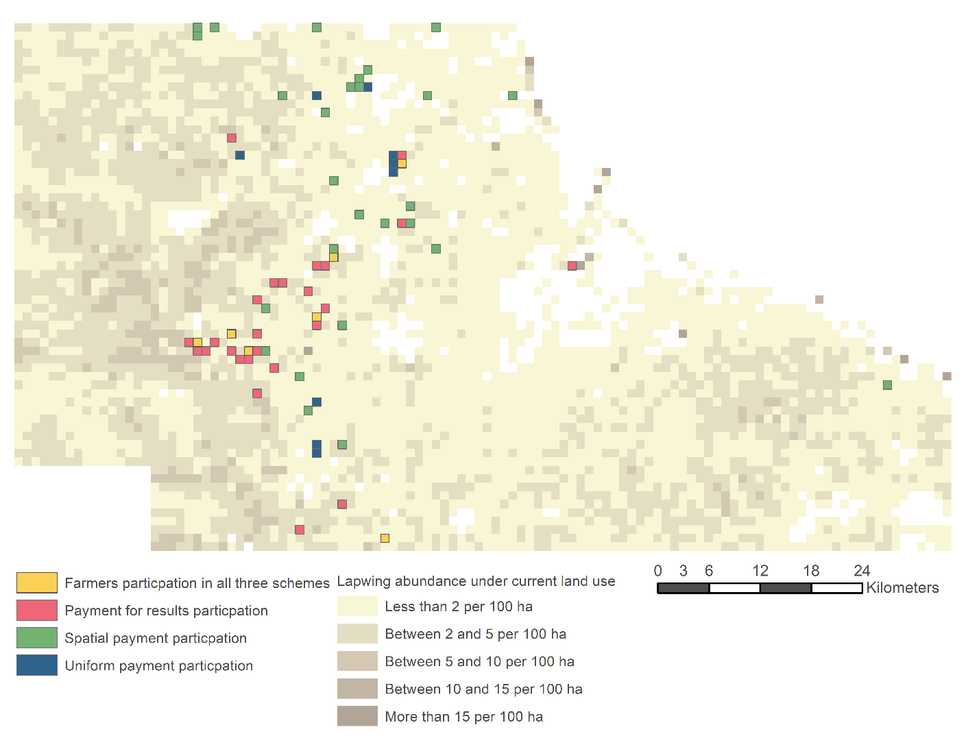

Slide 86
Finding 2: Ecological outcomes

Slide 87

Discussion
  Take home message 1: payment by modelled results appears to be cost effective for this case study region
  Greater ecological gains for target species (lapwing) as well as for 2 off-target species (curlew and oystercatcher), even though smaller area of restored grassland is created

Slide 88
Limitations
  Payment for modelled results does not encourage farmers to use their own knowledge on how best to produce the desired environmental outcome.
  Species abundance model does not take into account temporal dynamics; there no time lags between the restoration of grassland and increased species abundance in our model.

Slide 89
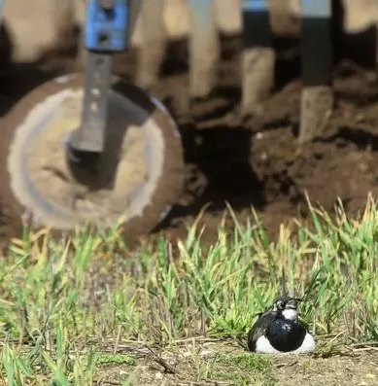
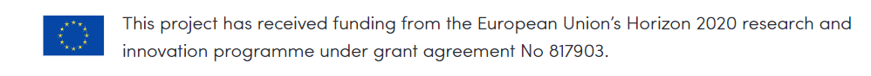

Any questions?
  Contact:
  Nick Hanley: nicholas.hanley@glasgow.ac.uk
  Kat Simpson: Katherine.Simpson@glasgow.ac.uk

Slide 90
Combining carrots and sticks to design more effective schemes
Mette Termansen, Kahsay H. Zemo, Raphael Fillippelli, Goytom A. Kahsay,
Abrha T. Abay, Carsten Daugbjerg & Bo J. Thorsen, University of Copenhagen, Denmark

Slide 91
TAKE HOME MESSAGE
Fixed-rate payments for environmental services in agricultural landscapes have not achieved the environmental targets for the EU and its member states
Uniform regulation through standards are costly due to the huge environmental & economic heterogeneity of agricultural landscapes
Combining strict enforceable collective caps on environmental damage while giving agency to farmers to find local solutions is feasible
Coordination mechanisms among farmers and between environmental agencies and farmers should be carefully developed to avoid counter productive outcomes

Slide 92
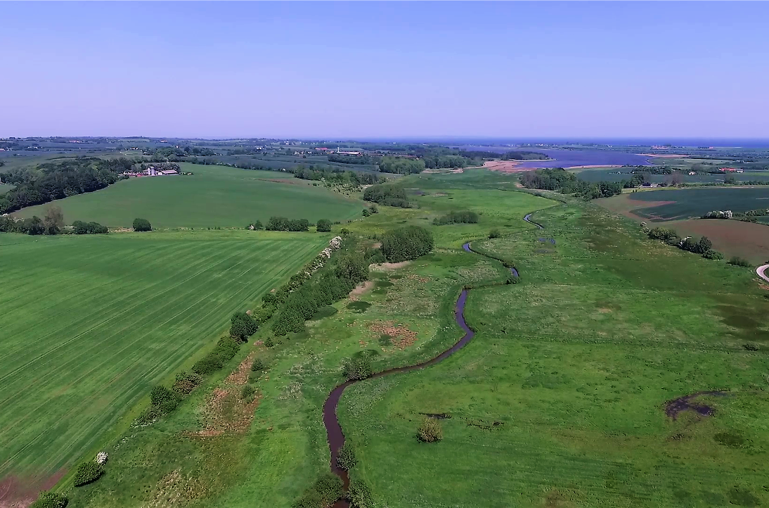
THE CASE:
The Danish Targeted Nitrogen Regulation: Evolution, Evaluation and Future Paths

Slide 93
A BRIEF HISTORY:
Danish Nitrogen Regulation
Eutrophication emerges as a political issue in the 1980s
– initiate conflicts over agricultural and environmental priorities.
1993 agreement on the Action Plan for Sustainable Farming
- introduces uniform nitrogen application standards
Growing opposition from the sector and rising compliance costs
- Evolution to the 2015 Agricultural Accord
- A paradigm shift towards environmentally targeted regulation
& from polluter pays towards beneficiaries pay

Slide 94
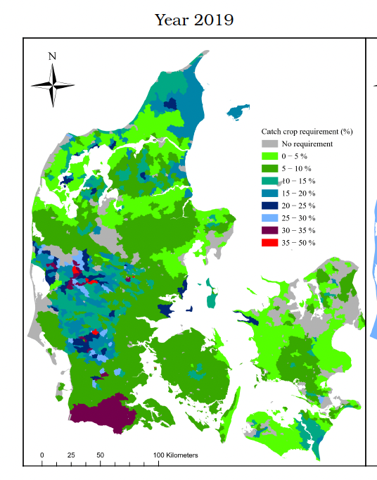
INNOVATION IN THE TARGETED Nitrogen Regulation
  Incorporation of ecological and hydrological catchment properties in the scheme design to allow environmental targeting.
  Replace N-input standards with compensated N-catch crops to enhance nutrient retention (with some flexibility to farmers in the choice of measures).
  Inclusion of a cap on total emissions to downstream water bodies in scheme design.
  If voluntary commitments are insufficient to restrict emissions below the environmental targets, mandatory uncompensated mitigation is imposed (standard).

Slide 95
Emerging QUESTIONS:
  1. Are the N-catch crop measure (and the other eligible agri-environmental practices) cost-effective in meeting N-reduction targets ?
  2. Has the targeted scheme been effective ? What is the evidence ?
  3. Does the scheme encourage effective coordination between farmers in the catchments ?
  4. Can the coordination mechanisms be improved ?

Slide 96
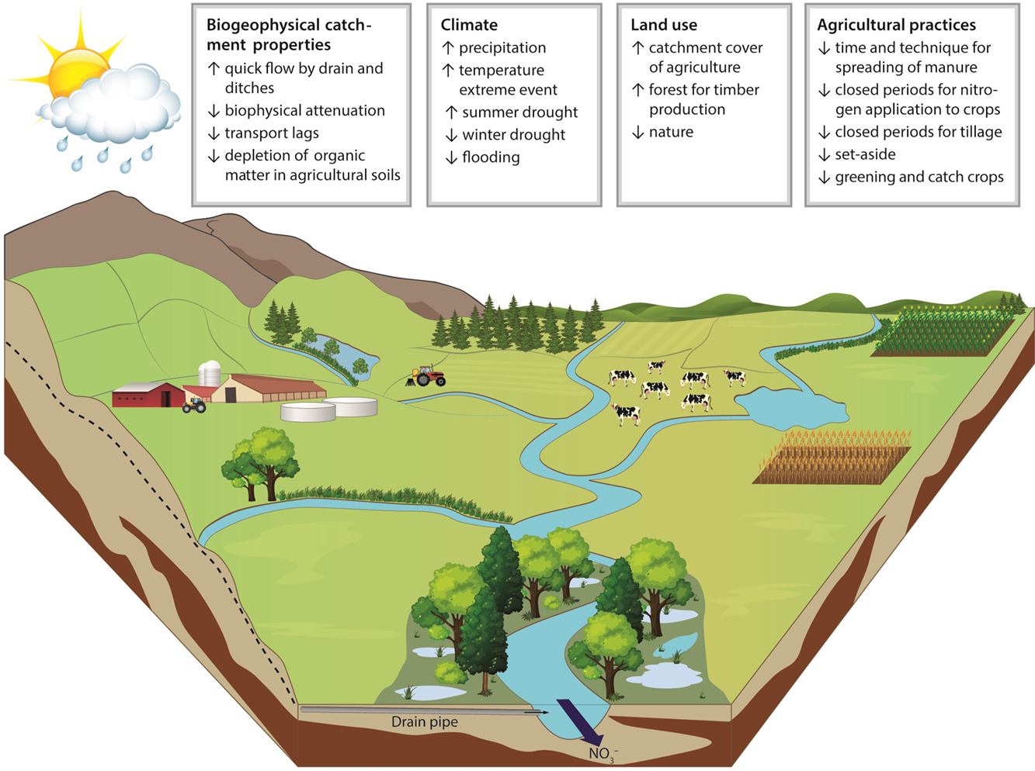
RQ1: What are the cost-effective measures to reach Water Quality targets
Used integrated spatially explicit ecological-economic modelling (TargetEconN) to generate a baseline for analysis of voluntary AES interventions. Compared input standards, targeted regulation practices, land-use change interventions, interventions in the sink (wetlands & marine measures).
Result: Cost-minimisation scenario for 108
catchments to achieve total reduction of
13,075 ton
Measure | Reduced N (ton) | %
N Input reduction | 91 | 0.7%
Catch-crops & other eligible measures | 434 | 3.3%
Land use change interventions (Pillar II) | 12,486 | 96%
Filippelli et al. (2023). Integrated environmental-economic
modelling for cross sectoral water policy evaluation (Under review)
Illustration from Petersen et al. (2021).
Science of the total environment (787).

Slide 97
RQ2: Has the targeted scheme been effective ? What is the evidence ?
Ex-post impact evaluation:
Results (preliminary):
We used nine years of agricultural
account statistics data.
Focused on the program’s impact on farm level purchased nitrogen and crop revenue.
We used Two-Way Fixed Effects (TWFE) regressions with sufficient controls to account for self-selection bias
Program participation has had a minimal
impact on nitrogen purchases
The effort has not been allocated to the
most effective locations
(not achieved within catchment targeting)
…but has led to a small (but significant)
reduction in farm crop revenues
Strengths: Based on real decisions, in real landscapes, by real farmers
Limitations: Data does not allow robust assessment of water quality outcomes
& we are not able to test alternative scheme design

Slide 98
RQ3: Does the scheme encourage effective coordination between farmers in the catchments ?
RQ4: Can the coordination mechanisms be improved ?
Focus on internal coordination mechanisms:
Success indicators of a collective scheme:
Use experiments to conduct an ex-ante evaluation
of alternative collective scheme designs:
Coordination of nitrogen mitigation effort between farmers in response to collective scheme design
Environmental effectiveness,
Social Welfare and Equity

Slide 99



Experimental set-up
Mimic the features in the Danish Targeted Nitrogen Regulation
Farmers in a catchment
Incentive mechanisms
Regulator
N leaching
Sets N load target
Waterbody
Design features:
Collective load reduction requirement
Subsidy
Subsidy reduction threat if target is not met
Bonus
Internal coordination:
Exclusion from the collective scheme
Transfer of subsidy between farmers to encourage
mitigation effort from environmentally effective areas

Slide 100
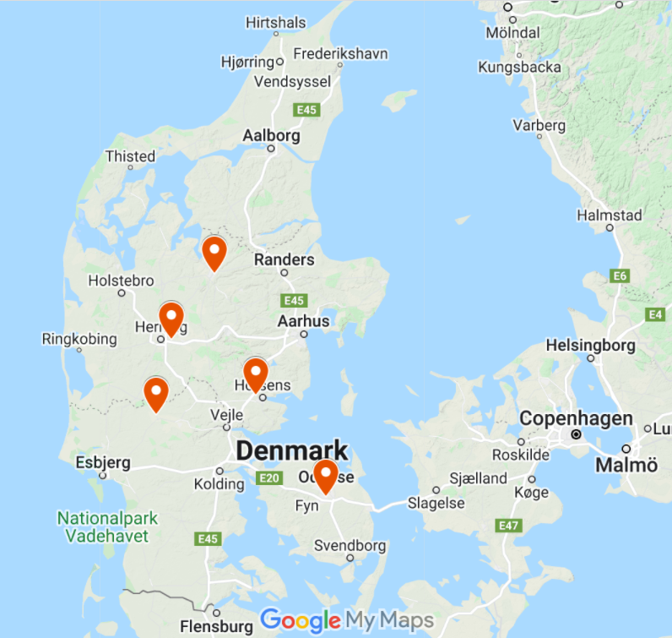

Experimental Implementation
We conducted a framed ‘field’
experiment in agricultural schools
Participants: 186 next-generation farmers
    Production managers
    Agricultural production economist
Web based interactive experiment
Participants use their own computer
Asmildkloster
Agroskolen
Bygholm
Grinsted
Dalum
Gråsten

Slide 101
Experimental Findings
Our findings suggest a potential for collective agri-environmental approaches combining carrots (voluntary including a subsidy) and stick (mandatory element to achieve the required reduction)
Collective designs do achieve the required voluntary participation (i.e. incentivize the requited effort to meet the target).
However, our findings suggest that the internal enforcement mechanisms can have adverse effects
          Participants do not transfer sufficient subsidy to make them environmentally effective (the effective farmers are not encouraged enough)
          Participant are too keen to exclude group members (underperforming farmers are punished too much) – undermines social welfare and equity outcomes

Slide 102
Conclusions
The case study shows that the evolution of the Danish nitrogen regulation has been shaped over time by negative and positive feedbacks between different stakeholders (farmer unions, environmental interest groups and government agencies).
A successful scheme is likely to require higher flexibility and include more effective measures (i.e. catch-crops and the current eligible measures are not sufficiently effective). Need to include land-use change and sink measures such as restoration of wetlands.
Allocation of effort to produce local public good may be improved using hybrids of top-down and bottom-up models.
Caution is needed regarding the use of internal enforcement mechanisms.
More ex-post evaluation of AES is necessary to evaluate whether AES goals actually live up to their intended goals.
A mix of methods (experiments and modelling) can support development of new AES in collaboration with farmers, farm advisors and programme developers.

Slide 103
Acknowledgements
Michael Friis Petersen & Jakob Vesterlund Olsen
Department of Food and Resource Economics, University of Copenhagen
Frank Bondgaard, Jacob Krog, Mads Lægdsgaard Madsen & Irene Viborg
Seges Innovation
Berit Hasler,
Department of Food and Resource Economics, University of Copenhagen
Gregor Levin,
Department of Environmental Science, Aarhus University
Hans E. Andersen,
Department of EcoScience, Aarhus University
Line Block Hansen,
Danish Climate Council (previously Aarhus University)
Jim Smart & Lin Hassan
Griffith School of Water Resources, Brisbane, Australia

Slide 104
Novel design mechanisms to increase the effectiveness of Agri-environmental schemes
Uwe Latacz-Lohmann and Chi Nguyen
Kiel University, Germany

Slide 105
Novel design mechanisms - Overview
Collectively organized nature conservation (Netherlands)
Payment by results: rewarding farmers for conservation outcomes rather than activities
Conservation auctions: allocate contracts through competitive bidding
Spatial coordination of conservation activities
Social norms interventions: Securing environmental gains in the long run

Slide 106
Novel design mechanisms - Overview
Collectively organized nature conservation (Netherlands)
Payment by results: rewarding farmers for conservation outcomes rather than activities
Conservation auctions: allocate contracts through competitive bidding
Spatial coordination of conservation activities
Social norms interventions: Securing environmental gains in the long run

Slide 107
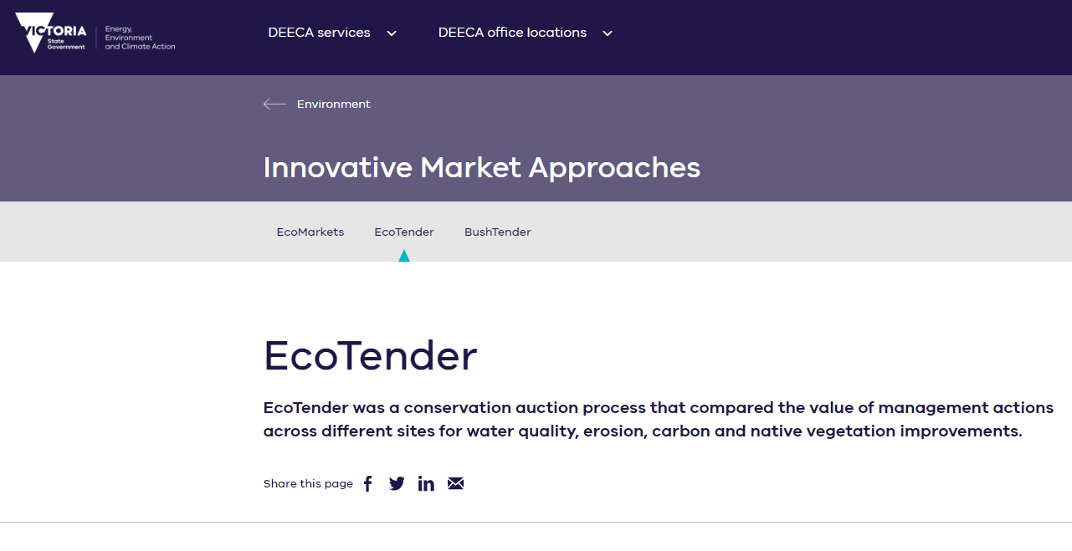



Conservation auctions

Slide 108
Why auctions?
Cost revelation: bidders reveal their costs with the bids
Price discovery: harness information held privately by bidders in determining prices for public goods
Cost-effectiveness: more environmental benefit for the €
Auctions as a ‘market‘ for public goods
Fairness: tendering is perceived to be fair

Slide 109
Auctions vs. fixed payments: how much better?
Auction experiment Kiel/Perth: Cost savings 30 to 60%, quickly eroding with repetition
Bidder learning poses a substantial threat to the functioning of multiple-round conservation auctions
Challenge Fund (Forestry Commission, Scotland): 33 to 36% efficiency gains, at an estimated 20% additional FC staff time
In EU: preference for cooperative approaches, equal treatment mentality

Slide 110
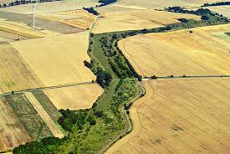
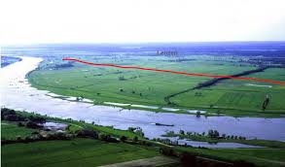
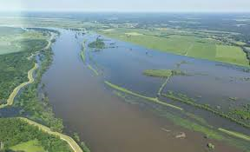
Spatial coordination
Where spatial coordination can improve environmental outcomes:
Corridors for wildlife migration
Minimum viable habitat size
Creation of options for re-colonisation
Creation of flood retention areas or moorland conservation

Slide 111
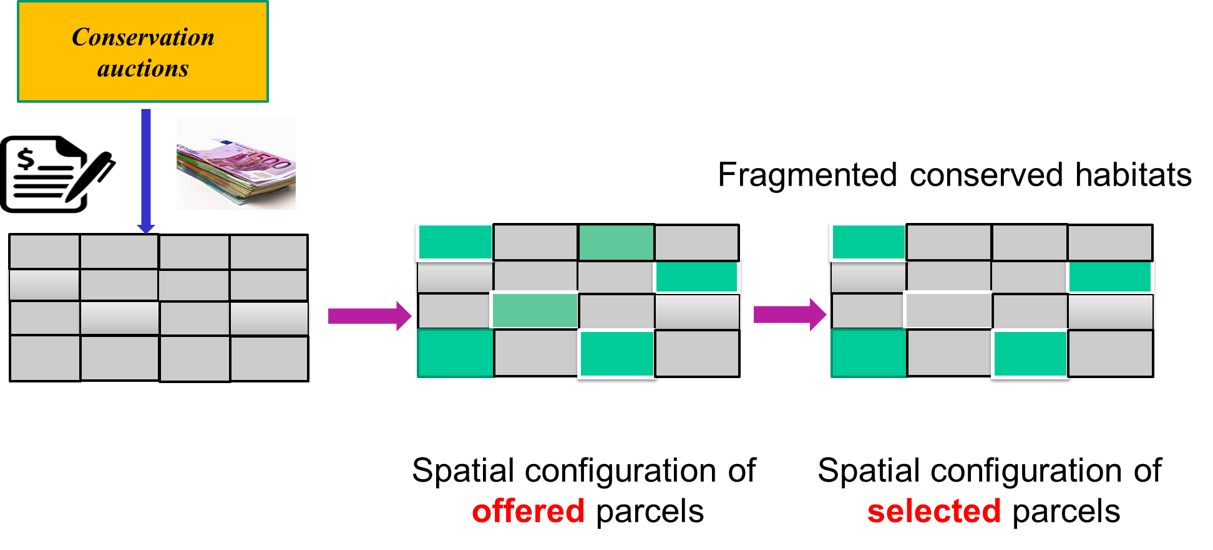
EFFECT: Spatial coordination & auctions

Slide 112
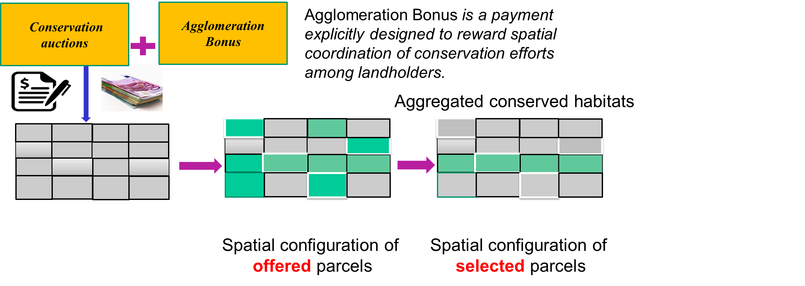
Spatial coordination & auctions

Slide 113
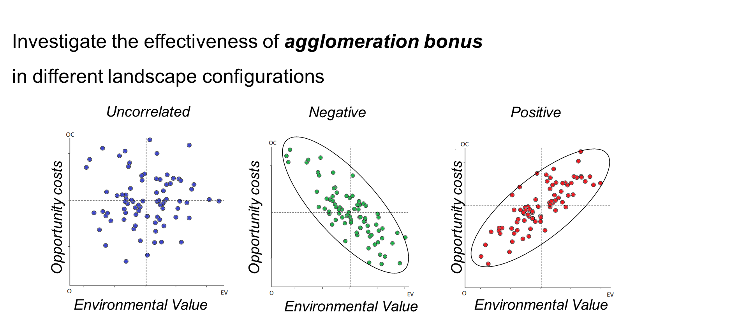
Spatial coordination & auctions

Slide 114
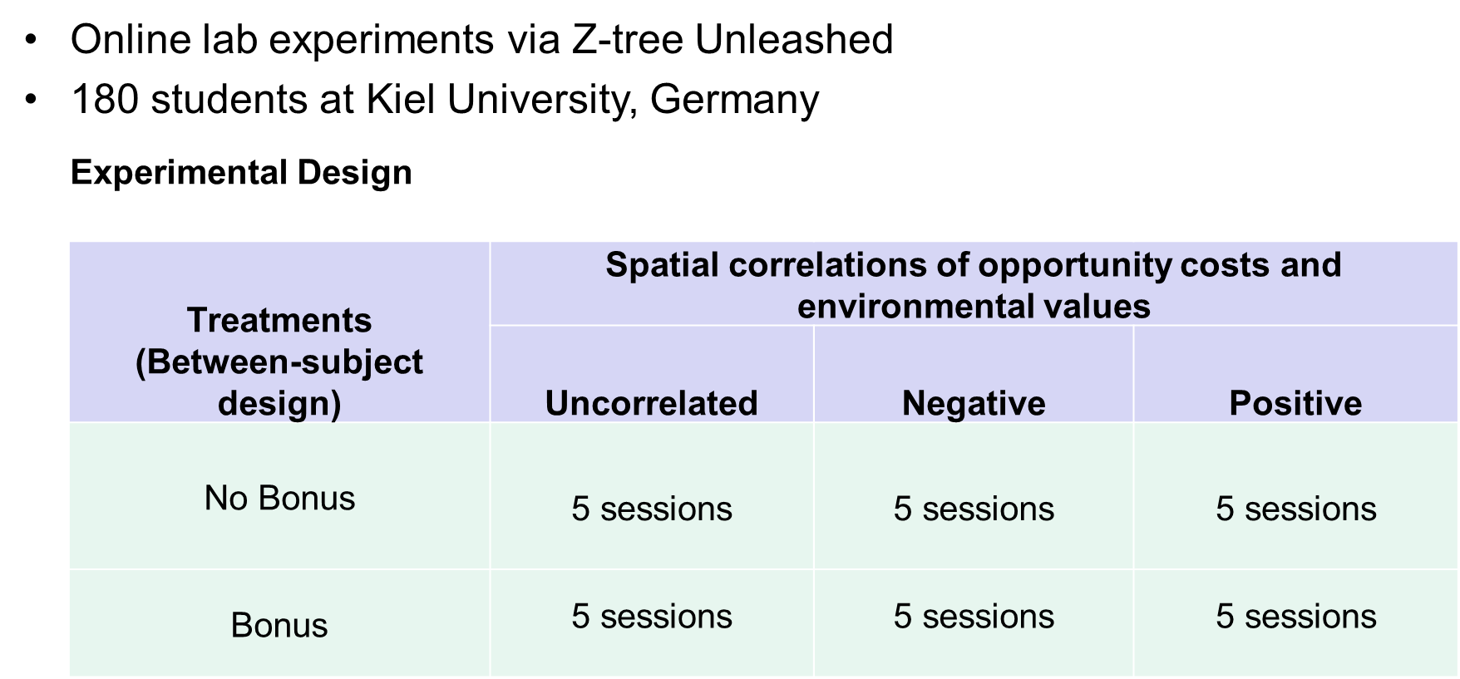
Spatial coordination & auctions

Slide 115
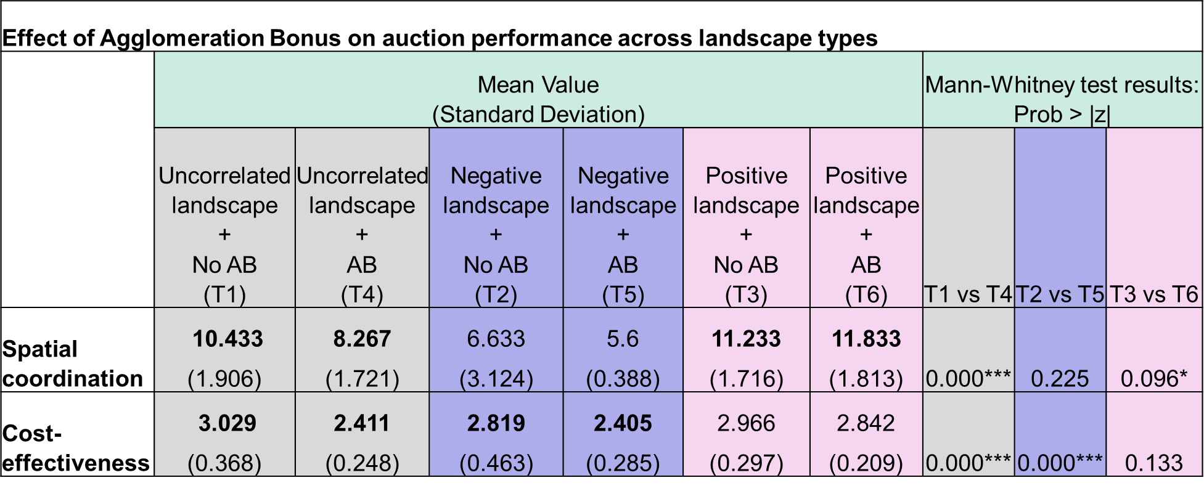
Spatial coordination & auctions

Slide 116
Insights for Policy
AB reduces the auction’s cost-effectiveness in the uncorrelated and negative landscape (no significant effect in the positive landscape)
AB reduces spatial coordination (of selected parcels) in the uncorrelated and negative landscape
AB enhances spatial coordination only in the positive landscape (where it is expensive to enrol high natural value land)
→
Policymakers should be very cautious including AB in conservation auctions

Slide 117
Thank you for your attention
EFFECT final event
4 October 2023, Brussels

